Slide 1
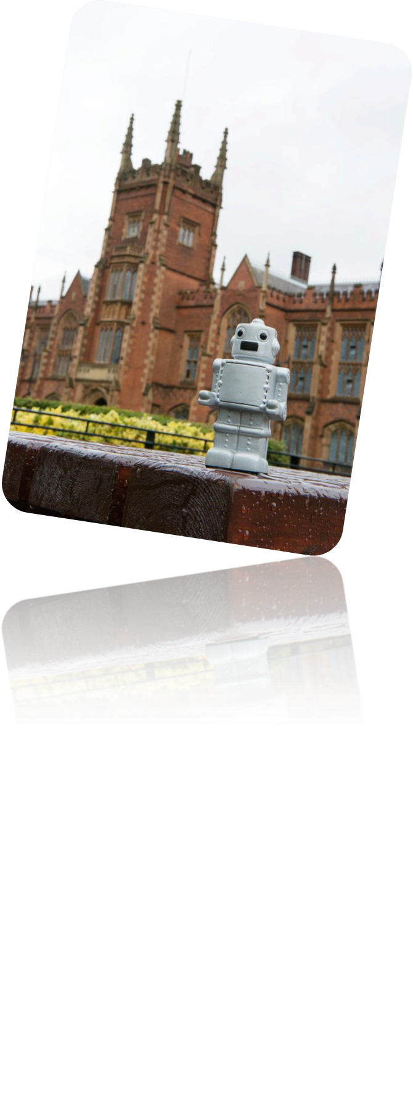
Programming One (csc7050)
Aidan McGowan
Arrays

Slide 2
Arrays
Data Structures—collections of related data items. Arrays are data structures consisting of related data items of the same type.
Arrays make it convenient to process related groups of values.
Arrays remain the same length once they’re created, although an array variable may be reassigned such that it refers to a new array of a different length.

Slide 3
Arrays introduction
An array is a group of variables (called elements or components) containing values that all have the same type.
Arrays are objects, so they’re considered reference types.
The elements of an array can be either primitive types or reference types (including other arrays)
To refer to a particular element in an array, we specify the name of the reference to the array and the position number of the element in the array.
The position number of the element is called the element’s index or subscript.

Slide 4
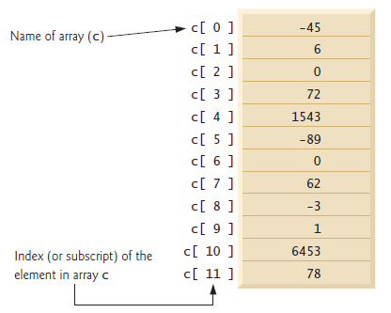
Arrays introduction - accessing
The logical representation of an integer array called c.
This array contains 12 elements.
A program refers to any one of these elements with an array-access expression that includes the name of the array followed by the index of the particular element in square brackets ([])

Slide 5
Arrays introduction - index
An index must be a nonnegative integer.
A program can use an expression as an index.
For example, if we assume that variable a is 3 then the statement
c[11] = a;
assigns 3 to array element c[11].
An indexed array name is an array-access expression, which can be used on the left side of an assignment to place a new value into an array element.

Slide 6
Arrays introduction - length
The name of the array is c.
Every array object knows its own length and stores it in a length instance variable. The expression c.length accesses array c’s length field to determine the length of the array.
This array’s 12 elements are referred to as c[0], c[1], c[2],…, c[11]
The value of c[0] is -45, the value of c[1] is 6, the value of c[2] is 0, the value of c[7] is 62 and the value of c[11] is 78.

Slide 7
Arrays introduction – first and last
The first element in every array has index zero and is sometimes
called the zeroth element.
Thus, the elements of array c are c[0], c[1], c[2] and so on….
The highest index in array c is 11, which is 1 less than 12 — the number of elements
in the array.
Array names follow the same conventions as other variable names.

Slide 8
Arrays introduction - expressions
To calculate the sum of the values contained in the first three elements of array c and store the result in variable sum:
sum = c[ 0 ] + c[ 1 ] + c[ 2 ];
To divide the value of c[6] by 2 and assign the result to the variable x
x = c[ 6 ] / 2;

Slide 9

Creating and Declaring an array
Array objects occupy space in memory. Like other objects, arrays are created with keyword new. To create an array object, you specify the type of the array elements and the number of elements as part of an array-creation expression that uses keyword new.
Such an expression returns a reference that can be stored in an array variable.

Slide 10
Creating and Declaring an array
Creating an array can also be performed in two steps
In the declaration, the square brackets following the type indicate that myArray is a variable that will refer to an array (i.e., the variable will store an array reference). In the assignment statement, the array variable myArray receives the reference to a new array of 11 int elements

Slide 11
Creating and Declaring an array – default values
When an array is created, each element of the array receives a default value—zero for the numeric primitive-type elements, false for boolean elements and null for references.

Slide 12

Creating on one line – not pretty !
A program can create several arrays in a single declaration
But difficult to read .. so avoid the above.

Slide 13
Array types
A program can declare arrays of any type. Every element of a primitive-type array contains a value of the array’s declared element type. Similarly, in an array of a reference type, every element is a reference to an object of the array’s declared element type.
For example, every element of an int array is an int value, and every element of a String array is a reference to a String object.

Slide 14
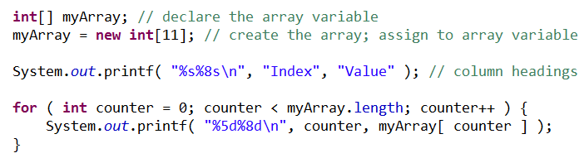
Iterating through an array
The for statement outputs the index number (represented by counter) and the value of each array element (represented by array[counter]).
The loop-control variable counter is initially 0—index values start at 0, so using zero-based counting allows the loop to access every element of the array.

Slide 15
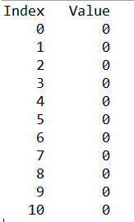
Iterating through an array
The for’s loop-continuation condition uses the expression array.length to determine the length of the array.
The loop-control variable counter is initially 0—index values start at 0, so using zero-based counting allows the loop to access every element of the array.

Slide 16
Iterating through an array
The length of the array is 11, so the loop continues executing as long as the value of control variable counter is less than 11.
But the highest index value of a 11-element array is 10, so using the less-than operator in the loop-continuation condition guarantees that the loop does not attempt to access an element beyond the end of the array (i.e., during the final iteration of the loop, counter is 10).
Notes:
Note – slight change from original notes

Slide 17
Using an Array Initialiser
It is possible to create an array and initialize its elements with an array initialiser —a comma-separated list of expressions (called an initialiser list) enclosed in braces.
the array length is determined by the number of elements in the initialiser list.

Slide 18
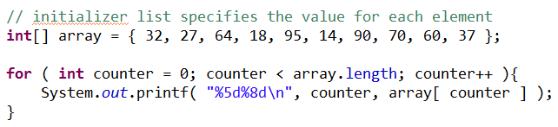
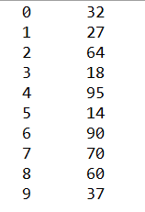
Using an Array Initialiser

Slide 19
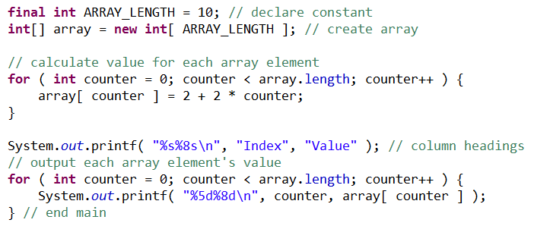
Dynamically populating an array
The modifier final is used to declare the constant variable ARRAY_LENGTH with the value 10. Constant variables must be initialized before they’re used and cannot be modified thereafter.

Slide 20
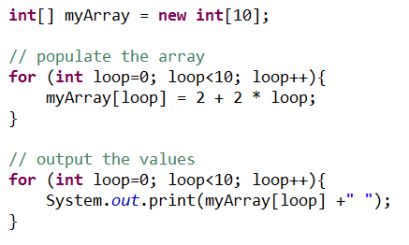
Dynamically populating an array
Notes:
Java has well-defined rules for specifying the order in which the operators in an expression are evaluated when the expression has several operators. For example, multiplication and division have a higher precedence than addition and subtraction. Precedence rules can be overridden by explicit parentheses.
Precedence Order.
When two operators share an operand the operator with the higher precedence goes first. For example, 1 + 2 * 3 is treated as 1 + (2 * 3), whereas 1 * 2 + 3 is treated as (1 * 2) + 3 since multiplication has a higher precedence than addition.

Slide 21
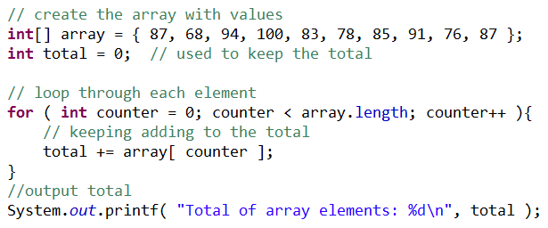
Summing the elements in an array

Slide 22

Arrays – exercise I
Create an array to hold the following shoes sizes.
11,10,10,9,11,9,11,8.5
Output each individual size and then the average size.
Notes:
public static void main(String[] args) {
int[] feetSize;
int total, average;
total =0;
average =0;
feetSize = new int[4];
// populate the array
feetSize[0] = 6;
feetSize[2] = 7;
feetSize[3] = 5;
feetSize[1] = 4;
// iterate through the array
for (int loop=0; loop<feetSize.length; loop++){
System.out.println(loop +" size : " +feetSize[loop]);
total+=feetSize[loop];
}
// calculate average and output to screen
average = total / feetSize.length;
System.out.println("Average is : "+average);
}

Slide 23
Passing an array to a method
To pass an array argument to a method, specify the name of the array without any brackets. For example, if array hourlyTemperatures is declared as :
then the method call
passes the reference of array hourlyTemperatures to
method modifyArray.

Slide 24
Array parameter declaration
For a method to receive an array reference through a method call, the method’s parameter list must specify an array parameter. For example, the method header for method modifyArray might be written as

Slide 25
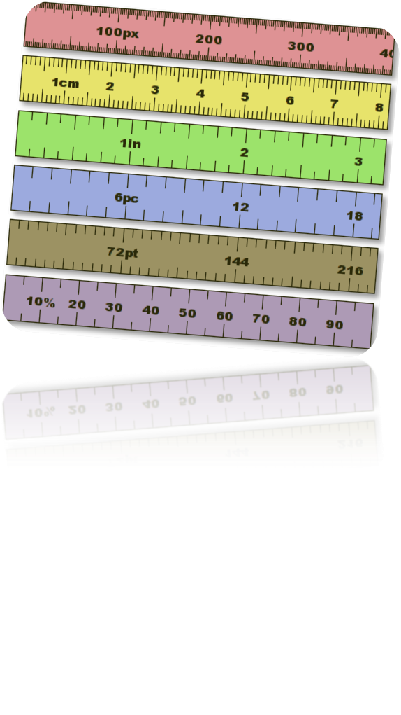
What about the length of the array?
Every array object “knows” its own length (via its length field). So when we pass an array object’s reference into a method, we need not pass the array length as an additional argument.

Slide 26
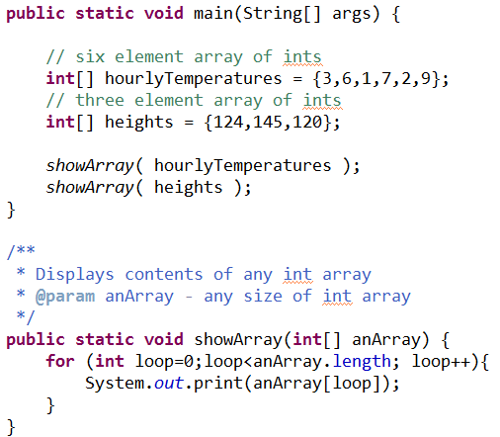

Type is important not the length

Slide 27
Passing the array vs. array element
When an argument to a method is an entire array or an individual array element of a reference type, the called method receives a copy of the reference.
However, when an argument to a method is an individual array element of a primitive type, the called method receives a copy of the element’s value. Such primitive values are called scalars or scalar quantities.
Notes:
http://www.programmerinterview.com/index.php/java-questions/does-java-pass-by-reference-or-by-value/

Slide 28
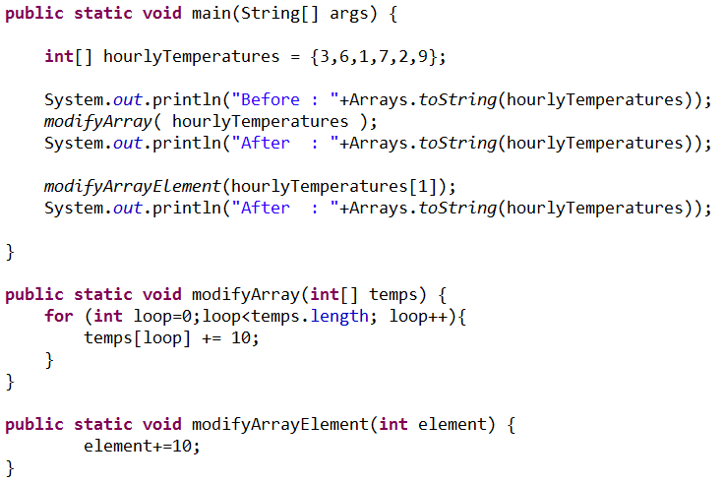

Passing the array vs. array element

Slide 29
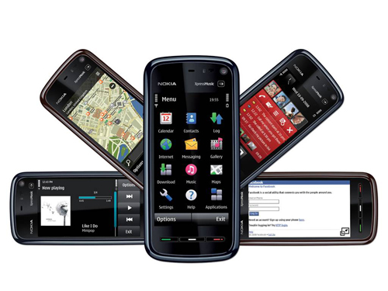
Arrays – exercise II
Complete the online survey..
From the class results create an array to hold each survey result for each phone type
Use the array to output the result for each –the Total responses
The most popular phone(s)
Notes:
https://docs.google.com/forms/d/1p9nnnf_LgT3g8iMwDxTFoAQwjqP-lq8bUpHsQqi_iSc/viewform?usp=send_form
/**
* Creates the array to store the results of the Mobile Survey.
* Then the array to another method to analyse the results.
* @param args
*/
public static void main(String[] args) {
// array to store mobile survey results
int[] results = new int[6];
// android
results[0] = 30;
// iphone
results[1] = 25;
// blackberry
results[2] = 5;
// windows
results[3] = 4;
// other
results[4] = 6;
// don't know – seriously ?
results[5] = 20;
// method call
analyseResults(results);
}
/**
* Loop through the array lists outputting the details.
* @param results (array of results from Mobile survey)
*/
public static void analyseResults(int[] results){
int total =0;
for (int loop=0; loop<results.length;loop++){
switch (loop){
case 0 :
System.out.print("Android ");
break;
case 1 :
System.out.print("iphone ");
break;
case 2 :
System.out.print("BlackBerry ");
break;
case 3 :
System.out.print("Windows ");
break;
case 4 :
System.out.print("Other ");
break;
case 5 :
System.out.print("Unknown ");
break;
default :
System.out.println("Error");
}
// keep running total
total+=results[loop];
// frequency
System.out.print(results[loop]);
System.out.println();
}
System.out.println("Total responses : "+total);
}

Slide 30
